Slide 1
Thermal Properties of Polymers
The thermal properties of polymers determine the performance, end use and processability of these materials.
The behaviour of a polymer on heating may be characterized by one of two transition temperatures:
(1) the melting temperature, T_{m} and
(2) the glass transition temperature, T_{g}.

Slide 2
These two parameters, T_{g} and T_{m} determine melt processing temperatures for amorphous and semicrystalline polymers, respectively.
One of the main advantages of polymers is that they can be easily manufactured in a variety of shapes.
This is because the transition from the solid to the "liquid" state (for polymers we will see that it is more appropriate to talk about "viscous liquid" state) occurs at relatively low temperatures, thus , favoring processability of these materials in the melt

Slide 3
The end-use of a polymer is largely dependent upon its T_{g} and/or T_{m}.
For example, we will see that only polymers with low glass transition temperature (T_{g}<< RT or below the working temperature) display elastomeric behaviour.
This is because high deformation is associated with the ability of the chains to rotate about the chemical bonds under the influence of an applied force. Only at temperatures above T_{g} is there sufficient thermal energy for conformational transitions to take place.

Slide 4
On the contrary, thermoplastics need to have relatively high glass transition temperatures compared to room temperature (or the working temperature).
Close to the glass transition (for amorphous solids) and/or T_{m} (for semicrystalline polymers), a thermoplastic material softens, losing its mechanical strength and dimensional stability.
Thus T_{g} and T_{m} determine the upper limit of application for rigid and flexible plastics.

Slide 5
Glassy and Crystalline State
The thermal properties of small molecules. Most low molar mass materials crystallize on cooling below the crystallization temperature T_{c} forming three-dimensionally ordered structures.
In the crystalline phase, the atoms occupy fixed positions (although vibrations occur around the lattice sites). On heating above the melting temperature, T_{m}, a phase transition takes place from the ordered structure to the disordered liquid phase. The atoms or molecules in the liquid phase are in continuous random motion.

Slide 6
Glassy and Crystalline State

Slide 7
Glassy and Crystalline State
We will see later in the section dedicated to liquid crystallinity that some materials (small molecules as well as polymers) may exhibit other phases between the ordered solid and the disordered liquid states. These phases are called "mesophases".
It is generally believed that most materials can be obtained in the glassy state.

Slide 8
Glassy and Crystalline State
A glass is a solid that retains the disorder of the liquid state and can therefore be considered as a "frozen liquid". Molecules in a glass occupy fixed positions (although vibrations may take place around mean positions as well as other local motions) but they are arranged randomly i.e. there is no long-range order.

Slide 9
Glassy and Crystalline State
Glassy materials may be produced on fast cooling from the liquid phase.
In particular, in order to avoid any crystallization the rate of cooling has to be faster than the rate of crystallization.
Thus, depending on how fast the molecules tend to crystallise it may not always be possible to form a glass. This is usually the case for small molecules and metals.

Slide 10
Glassy and Crystalline State
However, it is easy to produce glassy structures from polymers.
Some polymers
with irregular structure never form crystalline phases, even on slow cooling from the melt. This is true for commercial materials such as atactic polystyrene and poly(methyl methacrylate).

Slide 11
Glassy and Crystalline State
Other polymers instead are capable of forming crystalline phases , but, unlike small molecules, they never completely crystallize.
This is because, for a long polymer chain, crystallization from the melt is difficult. In the melt state, the chains are all tangled up and in order to form three-dimensionally ordered structures on cooling they need to pack side-by-side in an ordered fashion.
As shown below, it is very unlikely that the crystalline order extends to the entire polymer chain.

Slide 12
Glassy and Crystalline State
Polymers in the solid state can either be fully amorphous , i.e. forming a glass or at best semi-crystalline when disordered and crystalline regions coexist.

Slide 13
Definition of T_{g} and T_{m}
One of the simplest way to define the transition temperatures T_{g} and T_{m} is to consider the changes in volume that take place on heating. Volume-temperature curves can be determined experimentally using dilatometry, although this is not the preferred method of determining transition temperatures.

Slide 14
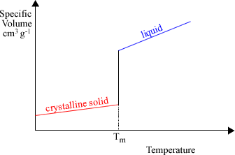
Definition of T_{g} and T_{m}

Slide 15
Definition of T_{g} and T_{m}
For low molar mass, crystalline materials the transition from the solid to the liquid state is sharp and occurs at a well defined temperature i.e. Tm.
The diagram above shows a plot of specific volume (remember that this is defined as 1/density of a material) versus temperature for a fully crystalline solid. The transition to the liquid phase is accompanied by a discontinuous change in volume at T_{m} (and similarly in the enthalpy). This discontinuity is characteristic of a first order transition. (The slopes of the volume-temperature curve below Tm and above Tm are related to the thermal expansion coefficients of the solid and liquid phases, respectively).

Slide 16
Definition of T_{g} and T_{m}
The situation differs considerably for a polymer glass. In this case, whether follow changes in volume or enthalpy, no sharp transition is observed on heating.
However, as temperature increases, the material softens over a broad temperature range and gradually changes its physical appearance from solid to "leathery" until at a higher temperature it becomes a viscous liquid.
This phase transition is considerably different from "melting" as it does not involve a change from ordered solid to disordered liquid.

Slide 17
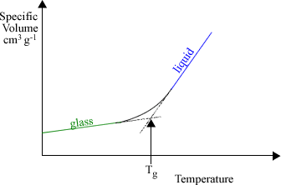
Definition of T_{g} and T_{m}

Slide 18
Definition of T_{g} and T_{m}
There is no discontinuity in the specific volume versus temperature curve shown above in proximity of the transition. The glass transition temperature, Tg, is defined as the point where a change in slope takes place. This is associated with a change in the thermal expansion coefficient from the glass to the liquid state. This type of transition which does not involve any discontinuity in the V-T curve (and similarly in the enthalpy versus T curve) is often called a second order transition.

Slide 19
Definition of T_{g} and T_{m}
The curve reported above is typical of glassy polymers such as atactic polystyrene, atactic polypropylene, poly(methyl methacrylate) and others that are unable to crystallize. Polymers with regular structures e.g. isotactic polypropylene and polyethylene form crystalline phases but the degree of crystallinity is generally less than 100%. As we mentioned earlier, crystalline order coexists with disordered amorphous regions and we therefore expect to observe two distinct transitions in the specific volume versus temperature curve:
(a) glass transition associated with the amorphous regions and
(b) melting temperature involving the transition from ordered to disordered liquid phase.

Slide 20
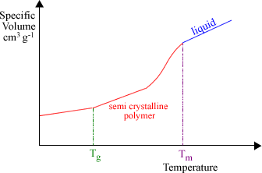
Definition of T_{g} and T_{m}

Slide 21
Definition of T_{g} and T_{m}
The transition from the crystalline to the liquid state is not sharp as we have shown earlier for small molecules. This is because, for polymers that are able to crystallize, there is always a distribution of size and degree of perfection( (حد الكمال of crystals. So melting for polymers occurs over a broad temperature range, depending on various factors such as molar mass, molar mass distribution and degree of branching. Since the transition is not sharp, it is more appropriate for polymers to talk about melting range instead of melting temperature.

Slide 22
Differential Scanning Calorimetry Instrument for measuring T_{g} and T_{m}

Slide 23
Differential Scanning Calorimetry Instrument for measuring T_{g} and T_{m}
Differential scanning calorimetry (DSC) has become the preferred method used for determining T_{g} and T_{m}. A schematic diagram with the main components of a DSC apparatus is shown above. It consists of two compartments containing the sample (in an aluminum pan) and a reference (an empty aluminum pan). Sample and reference are heated at a constant rate (usually 10 to 20 C/min) and this is kept constant throughout the experiment. The difference in the amount of heat that is required to keep sample and reference at the same temperature is measured. This is a measure of the heat capacity, c_{p} : c_{p} = Q / ΔT, where Q is the amount of heat and ΔT is the corresponding temperature change.

Slide 24
Differential Scanning Calorimetry Instrument for measuring T_{g} and T_{m}
When a transition takes place, there will be a change in the heat capacity. A DSC thermogram of a glassy polymer will only show on heating a change in heat capacity in correspondence of the glass transition temperature, T_{g}. The heat capacity of the polymer above T_{g} is higher than the heat capacity below T_{g} and therefore we need to increase the amount of heat supplied to the sample in order to keep it at the same temperature as the reference. This corresponds to an endothermic process.

Slide 25
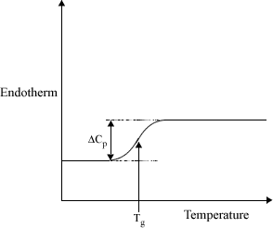
Differential Scanning Calorimetry Instrument for measuring T_{g} and T_{m}

Slide 26
Differential Scanning Calorimetry Instrument for measuring T_{g} and T_{m}
A semi-crystalline polymer will show a glass transition and a melting peak. As we approach the melting temperature, we need to supply an additional amount of heat to the system, the latent heat of melting, while the temperature remains constant. This process gives rise to an endothermic peak.

Slide 27
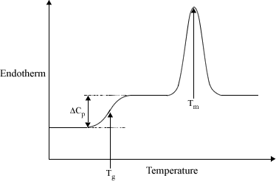
Differential Scanning Calorimetry Instrument for measuring T_{g} and T_{m}

Slide 28
The Degree of Crystallinity
The degree of crystallinity is defined as the fractional amount of polymer that is crystalline and it is either expressed in terms of the mass fraction, w_{c} or the volume fraction, j_{c}. For semi-crystalline polymers, the degree of crystallinity is one of its most important physical parameters since it reflects the sample’s morphology and determines various mechanical properties, such as the Young modulus, yield stress as well as the impact strength.
Differential scanning calorimetry is widely used to determine the amount of crystalline material. can be used to determine the fractional amount of crystallinity in a polymer sample. Other commonly used methods are X-ray diffraction, density measurements, and infrared spectroscopy.

Slide 29
The Degree of Crystallinity
In DSC, the weight fraction crystallinity is conventionally measured by dividing the enthalpy change associated with T_{m}, ΔH_{m} (in Joules per gram), by the enthalpy of fusion for a 100% crystalline polymer sample, ΔH_{m}º.

Slide 30
Factors Affecting the Glass Transition Temperature
For synthetic polymers, T_{g} values vary between 150 K to 500 K. This section deals with the relationship between T_{g} and chemical structure.
We can understand why polymers have different glass transition temperatures if we consider what happens to a chain as the sample is heated across T_{g}. In the glassy state, the chains are frozen into rigid conformations and only local motion can take place such as vibrations and side group rotations. As temperature increases so does the probability of rotation about the single bonds. When the average thermal energy becomes higher than the potential energy barrier between conformational states, then the local bonds will rapidly interchange among different conformations. The conformational transitions that take place at T_{g} are not isolated and localised but involve movement of neighbouring segments. It is this co-ordinated movement that is responsible for the change in physical appearance of the material at T_{g}. This is usually summarised by saying that the transition from glass to rubbery state marks the onset of long range, coordinated molecular motion.

Slide 31
Factors Affecting the Glass Transition Temperature
Because T_{g} is associated with molecular motion and internal rotations about chemical bonds, it is expected that whatever restricts rotational freedom should increase the glass transition temperature.
Both intra- and inter- molecular parameters affect T_{g}:
intramolecular parameters : chain stiffness, steric effects
intermolecular parameters : specific interactions between chains
We will see that, for low molar mass polymers, T_{g} varies with M_{n} and can be altered by addition of plasticisers and through random copolymerisation.

Slide 32
Effect of Chain Stiffness on T_{g}
As Tg depends on the ability of a chain to undergo internal rotations, we expect chain flexibility to be associated with low glass transitions. Poly(dimethyl siloxane) is an extremely flexible polymer due to the large separation between the methyl substituted silicon atoms
Compared to other polymeric materials, poly(dimethyl siloxane) has the lowest glass transition temperature (Tg = 150 K).

Slide 33
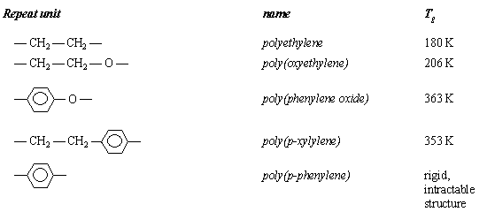
Effect of Chain Stiffness on T_{g}
Table – Effect of Chain Stiffnes
As shown in the Table , polymers that contain −CH2 −CH2 − sequences and ether linkages in the main-chain have relatively easy internal rotations and therefore low Tg values. Substitution of ethylene groups with p-phenylene units leads to increased chain rigidity and high glass transition temperature

Slide 34
Steric Effects on T_{g}
The presence of bulky side groups hinders rotation of the backbone atoms due to steric hindrance , and therefore results in an increase in T_{g}. The magnitude of this effect depends on the size of the side groups and it is possible to establish a correlation between the molar volume of the side group and T_{g}. This is illustrated in Table 2 for vinyl polymers having the general structure — [CH₂ — CHX ] — Table : Steric Effect
An increase of ca. 120 K is observed with increasing the size of the side group.

Slide 35
Steric Effects on T_{g}
For polymers of type
—[CH₂ — CYX ] —
steric hindrance effects are even more pronounced. As shown in Table , compared to poly(methyl acrylate), the glass transition of poly(methyl methacrylate) is 100 K higher.
Table – Steric Effects

Slide 36
Effect of Intermolecular Forces
The presence of polar side groups leads to strong intermolecular attractive interactions between chains which hinders molecular motion thus causing an increase in T_{g}. This effect is illustrated for the polymers of type
− [CH₂ − CHX ] −
reported in the Table The three substituents i.e. methyl, Cl and OH groups have comparable size and therefore hinder bond rotation to the same extent. However, the non-polar polypropylene has a T_{g} that is 100 K below that of polar poly(vinyl cloride) and poly(vinyl alcohol).
Table – Effect of Intermolecular Forces

Slide 37
Flexible Alkyl Chains and "Internal Plasticization
We have seen that, due to steric hindrance, the presence of bulky side groups causes an increase in T_{g}. However, this is only true if the side groups are rigid. Flexible alkyl chains cause a decrease in the glass transition temperature. This effect is illustrated below for the acrylate series: the glass transition decreases as the size of the side group increases.

Slide 38
Flexible Alkyl Chains and "Internal Plasticization
The effect is similar to the decrease in T_{g} that is observed due to addition of low molar mass compounds (i.e. plasticizers) and is therefore referred to as "internal plasticization". It is explained by considering that only the first units of the side group, i.e. − COO and −CH₂− groups which are closest to the chain provide steric hindrance to internal rotation. The additional flexible CH₂ units do affect the motion of the backbone atoms as they are flexible and can undergo rotations about side-chain bonds. As it will be evident from the discussion in the following section, the flexible side-chains, with their motion, produce an increase in free volume and this makes the motion of the backbone atoms less hindered. As a consequence the glass transition decreases.

Slide 39
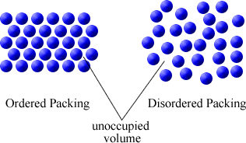
The Concept of Free Volume
In the previous section, we have introduced the word "free volume" to explain the decrease in T_{g} that takes place with increasing size of flexible side-chains attached to a polymer backbone. Although free volume cannot be easily measured experimentally, it provides a useful concept to understand how T_{g} varies with addition of plasticizers, with increasing polymer molar mass, etc.
The free volume, V_{f} , is defined as the space in a solid or liquid that is not occupied by the molecules i.e. the empty space. As shown below, amorphous solids present a relatively large amount of free volume compared to ordered materials due to inefficient packing.

Slide 40
Copolymerization and T_{g}
It is possible to alter the glass transition of a homopolymer by copolymerisation with a second monomer. If the two homopolymers prepared from the monomers have different T_{g}s, then it is reasonable to expect that their random copolymer should have a glass transition which is intermediate between the T_{g}s of the homopolymers. This is observed experimentally. The glass transition of a random copolymer is related to the T_{g}s of the homopolymers, T_{g1} and T_{g2}, as follows:
1/ T_{g} = w₁ / T_{g1} + w₂ / T_{g2}

Slide 41
Copolymerization and T_{g}
where w₁ is the weight fraction of homopolymer 1. This result is only valid for a random copolymer. For example, if we consider a di-block copolymer where the two blocks are incompatible, we expect two distinct T_{g}s which are associated with the two separate blocks.

Slide 44
where w₁ is the weight fraction of homopolymer 1. This result is only valid for a random copolymer. For example, if we consider a di-block copolymer where the two blocks are incompatible, we expect two distinct T_{g}s which are associated with the two separate blocks.

Slide 45
Other Factors Affecting T_{g}
Both cross-linking and crystallinity cause an increase of the glass transition temperature.
It is relatively easy to explain why cross-linking increases T_{g} since the presence of covalent bonding between chains reduces molecular freedom and thus the free volume. Similarly, the presence of crystalline regions embedded in an amorphous material restricts the mobility of the disordered amorphous regions. The glass transition increases to an extent that depends on the degree of crystallinity.

